Slide 1
Behavioral and Neural Mechanisms of Trauma Symptomatology in ASD in the ABCD Study
Tarjan Series February 22, 2021
Emily Wood, MD, PhD
Jillian Melbourne
Susan Bookheimer, PhD
Shula Green, PhD
Mirella Dapretto, PhD

Slide 2
Introduction
Autism Spectrum Disorder
Adverse Childhood Experiences (ACEs)
Haruvi-Lamdan et al., Psychological Trauma: Theory, Research, Practice, and Policy, 2018
Hoffman et al., Neurobiology of Stress 2019
Roberts et al., Child Abuse and Neglect, 2015
Notes:
Autism is a developmental disorder characterized by deficits in communication and social interaction and restrictive and repetitive behaviors. ACEs encompass a range of early life adversity such as neglect, abuse, and household challenges and are associated with poorer mental health outcomes. Studies suggest that children with ASD are prone to experiencing interpersonal trauma because of deficits in emotional expression and communication skills and are more susceptible to exposure to traumatic childhood events, bullying, and physical and sexual abuse when compared to typically developing peers. Not only are ASD children more likely to experience an elevated number of ACEs in their lifetime, but also we hypothesize that ASD youth have an increased risk of developing comorbid psychiatric conditions, including post-traumatic sequelae, after exposure to ACEs and traumatic experiences compared to typically developing youth.
########### Our literature review has revealed a disparity between previous studies of the comorbidity rate between ASD and PTSD. One study published by Mehtar and Mukaddes found that upwards of 17% of individuals recruited with ASD met criteria for a PTSD diagnosis whereas conflicting studies found a 0-3% comorbidity rate of ASD and PTSD. Even with various reported comorbidity rates, there remains little understanding of the mechanistic basis behind the prevalence of PTSD in individuals with ASD. We hypothesize that functional connectivity (fc) MRI in networks related to fear learning, sensory and emotion regulation such as the anterior insula, amygdala, and thalamus will mediate the relationship between group status, ACEs and PTSD symptoms. These regions are part of the salience network, an intrinsic neural network implicated in attentional modulation to stimuli. ASD individuals have consistently been found to show atypical connectivity in the salience network as well as weaker connectivity between the amygdala and brain regions responsible for social responsiveness and repetitive behaviors. Resting state research on individuals with PTSD have also identified atypical connectivity in the salience network associated with PTSD symptoms.
Put ASD first and ACEs after
Include theoretical model for why they might have more ACEs
What you say sets up the data we're looking at
Social stuff (interpersonal trauama)
Add first author et al. journal name, year for OG ACEs paper and papers about comorbidity of ASD and ACEs/Trauma

Slide 3
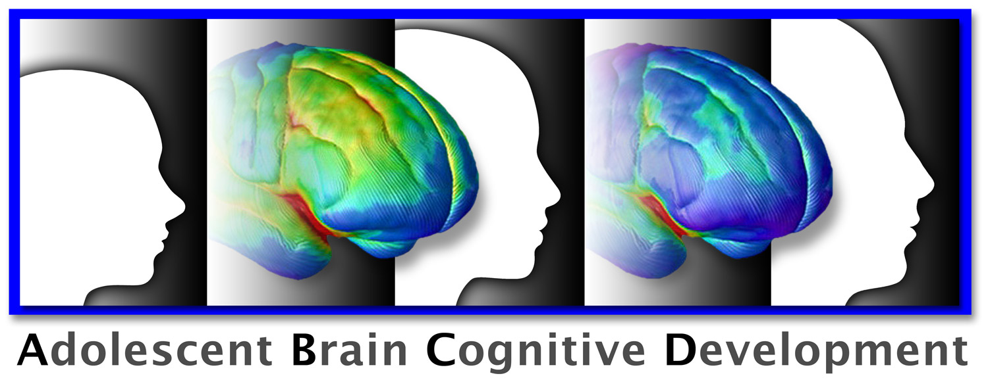
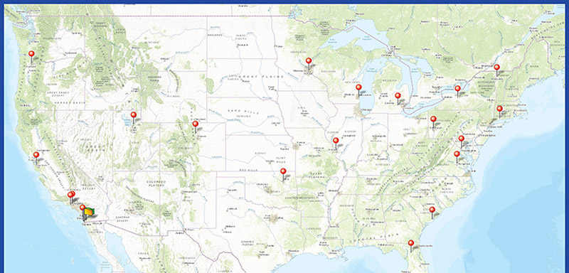
(ABCD) Cohort Size: 11,874 Youth
Notes:
Script: Organized by the National Institute on Drug Abuse and National institute on Alcohol Abuse and Alcoholism, the Adolescent Brain Cognitive Development, or ABCD, Study is the largest longitudinal study of brain development and child health to date. Investigators at 21 sites around the country, one of which is UCLA, will measure brain maturation in the context of social, emotional and cognitive development as well as a variety of health and environmental outcomes. We chose to source data from the ABCD study because of it includes quality controlled, resting state fMRI imaging data, measures for adverse childhood experiences, and a large cohort size of 11,874 participants. From this large cohort, we were interested in looking at adolescents with autism and neurodevelopmental disorders who also had PTSD.
Cohort Size: 11,874
201 Participants with parent reported ASD Diagnosis
Coordinated by the National Institute on Drug Abuse and National Institute on Alcohol Abuse and Alcoholism
Data accessible through NIMH Data Archive with Data Exploration and Analysis Portal (DEAP) tool and NIMH Data Dictionary
Includes behavioral data and quality controlled, resting state FMRI imaging data
The ABCD Study is a landmark study on brain development and child health that will increase understanding of environmental, social, genetic, and other biological factors that affect brain and cognitive development and can enhance or disrupt a young person's life trajectory.
, longitudinal study of brain development and child health. Investigators at 21 sites around the country will measure brain maturation in the context of social, emotional and cognitive development, as well as a variety of health and environmental outcomes.
Measure of interest: Kiddie Schedule for Affective disorders and schizophrenia

Slide 4
Post Traumatic Stress Disorder
Diagnostic Criteria
Exposure to trauma
Intrusive symptoms
Avoidance
Changes in mood and cognition
Hyperarousal
Functional impairment

Slide 5
ASD and Trauma
Interpersonal Trauma
Sensory Over-Responsivity
Notes:
Script: People with Autism are also more likely to experience trauma. Deficits in communication and emotional expression skills in people with Autism is believed to lead to higher rates of interpersonal trauma such as bullying. Similarly, people with Autism experience higher rates of physical and sexual assault, increased exposure to traumatic childhood events and higher rates of caretaker abuse. Now, as we discussed earlier, though exposure to trauma is a diagnostic criterion for PTSD, not everyone who is exposed to trauma develops post-traumatic sequelae. However we suspect that people with Autism are more likely to develop PTSD after being traumatized because they experience higher rates of sensory over responsivity which is defined as an intense or exaggerated response to what would otherwise be mildly aversive stimuli. For example, children with Sensory over-responsivity or SOR might not be able to tolerate itchy tags in clothing, loud noises such as sirens, or other sensations that someone without SOR might find mildly bothersome or even unnoticeable. Sensory over-responsivity produces avoidant behaviors that are also characteristic of PTSD and higher sensory sensitivity is correlated to increased cortisol in peer interactions. Our lab focuses on SOR and we hypothesize that sensory over-responsivity could be a mediating factor between ASD and stress response and could be mechanistically responsible for the development of PTSD from trauma in individuals with autism.
Deficits in communication and emotional expression skills
Higher rates of physical and sexual assault
Increased exposure of traumatic childhood events and bullying
Increased risk of caretaker abuse
42-88% comorbidity of SOR with ASD
Higher sensory sensitivity correlated with increased cortisol in peer interactions
Avoidant characteristics
Shared behavioral and neurobiological mechanisms between ASD and PTSD ⇒ we hypothesize that there is a higher comorbidity in kids with ASD
More prone to exposure of traumatic childhood events
SOR could be a mediating factor between ASD and stress response
SOR leads to avoidant behaviors that are also characteristic of PTSD
Factors that put people at high risk for developing ptsd
Rate of ACES events/traumatic experiences is higher in children with ASD ⇒ what are the mechanisms of developing PTSD symptoms and disorders
Add slide with trauma and PTSD
PTSD is a disorder of have x symptoms that result in decreased functioning following a trauma ⇒ not every person who experiences a traumatic event goes on to have PTSD
What are the relationships between autism and trauma vs autism and ptsd
When a trauma happens what is their fear response and bodily reaction to it

Slide 6
Participants – Matching
 | ASD (n = 192) | TD (n = 960) | P-value
Females (n) (%) | 26 (13.5%) | 135 (14.0%) | 𝛘², p = 0.93
Age (mean ± SD) | 120.2 ± 7.4 | 120.3 ± 7.4 | t-test, p = 0.89
IQ Composite (mean ± SD) | 45.8 ± 10.9 | 46.5 ± 13.6 | t-test, p = 0.52
SES (% FPL) (mean ± SD) | 3.5 ± 3.9 | 3.9 ± 2.7 | t-test, p = 0.74
% FPL (2018 Federal Poverty Level) = Annual Household Income /12,140 + (Household Size -1)*4,320
https://aspe.hhs.gov/2018-poverty-guidelines
Notes:
For the ABCD cohort, currently half of the participants lack follow-up data necessary for our analysis, so we will be focusing on the 4,950 subjects with complete baseline and1 year follow-up data. We defined our ASD sample by parent-reported autism diagnosis and found 60 ASD participants after exclusion based on missing data. A control group of 5:1 TD:ASD peers was established using nearest neighbor greedy matching on gender, IQ and socioeconomic status.
Add reference for FPL (website)

Slide 7
Demographics
Group | Asian | Black | Latinx | white | Multi | Other
ASD (n = 192) | 5 (2.6%) | 42 (21.9%) | 5 (2.6%) | 111 (57.8%) | 29 (15.1%) | 0 (0%)
TD (n = 960) | 31 (3.2%) | 206 (21.5%) | 55 (5.7%) | 485 (50.5%) | 166 (17.3%) | 17 (1.2%)
*Participants not matched on race or ethnicity

Slide 8
Adverse Childhood Experiences
Domains | # items | Visit
Community Violence | 2 | 0
 |  | 0
 | 1 | 2
 | 1 | 1
Discrimination | 1 | 1
Domestic Violence | 1 | 0
Emotional Neglect | 1* | 2
Family Budget Instability | 3 | 1
 | 2 | 1
Family Conflict | 1 | 1
 | 1 | 2
Family Delinquency | 2 | 1
 |  | 0
Family Mental Illness | 1 | 1
 | 3 | 0
 | 6 | 0
Family Substance Use | 1 | 1
Family/Friend Illness or Death | 5 | 1
 | 1 | 0
Food Insecurity | 1 | 1
Housing Instability | 4 | 1
Low Family Cohesion | 1 | 1
 | 7 | 1
Personal Delinquency | 1 | 1
Personal Illness/accident | 2 | 1
 | 4 | 0
Personal Violence | 1 | 1
Physical Abuse | 4 | 0
Physical Neglect | 1 | 2
School Instability | 1 | 1
 | 1 | 2
Sexual Abuse | 3 | 0

Slide 9
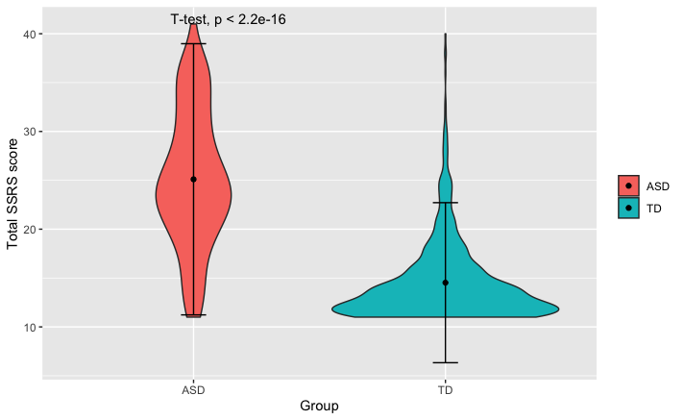
Substantiating ASD Diagnosis
KSADS Neurodevelopmental Module
Unusual body movements
Strict Routines
Poor Eye Contact
Short Social Responsiveness Scale (SSRS)
11-item parent-reported survey taken from the 65-item Social Responsiveness Scale-2 (SRS-2; Constantino, 2003 )
Identifies and measures the severity of impairment across social domains in ASD individuals
Notes:
KSADS Neurodevelopmental Module
Unusual body movements
Strict Routines
Poor Eye Contact

Slide 10
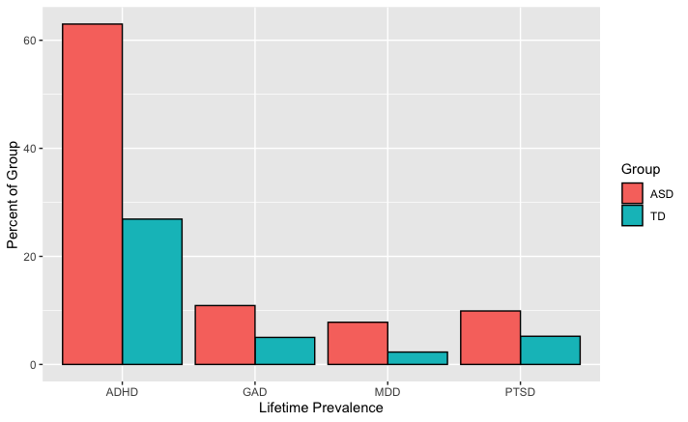
Comorbidities
Group | ADHD | GAD | MDD | PTSD
ASD (n = 192) | 121 (63%) | 21 (10.9%) | 15 (7.81%) | 19 (9.9%)
TD (n = 960) | 258 (26.9%) | 48 (5%) | 22 (2.29%) | 50 (5.21%)
ChiSq-value (p-value) | 93.1 (5.06E-22) | 8.99 (0.00271) | 14 (0.000187) | 5.44 (0.0197)

Slide 11
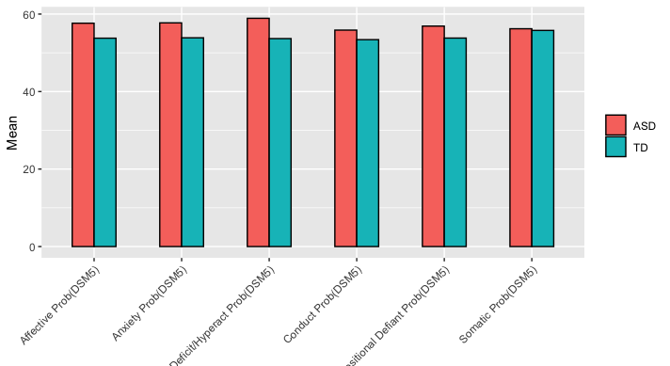
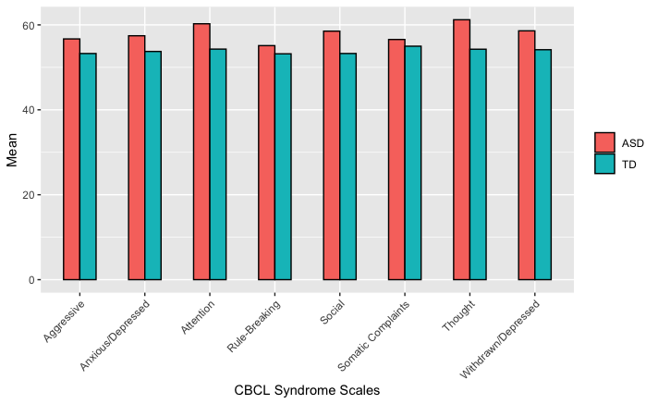
Child Behavior Checklist
Syndrome scales reflect sets of co-occurring problems and each scale does not map onto a DSM diagnostic category.
DSM-Oriented scales reflect a broad emotional or behavioral problem that correspond to a broad DSM diagnostic category
Notes:
All significantly different except somaticizing

Slide 12
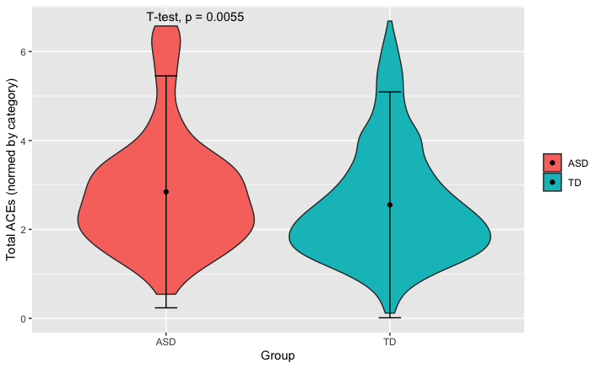
ACEs and PTSD symptoms between groups

Slide 13
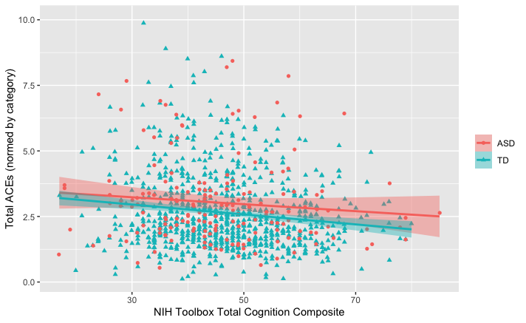
IQ & ACEs
NIHTBX Total used as covariate in all ACEs analyses
Notes:
interview_age_baseline 0.003632 0.006294 0.577 0.564
nihtbx_totalcomp_fc_baseline -0.018366 0.004167 -4.407 1.16e-05 ***
Control for SES?

Slide 14
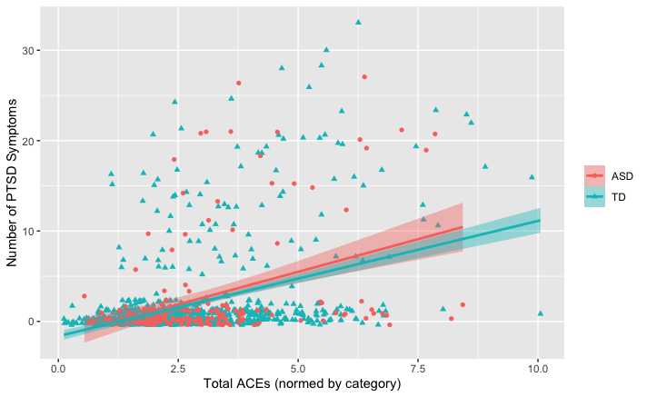
More ACEs is associated with more PTSD Symptoms
Adverse Childhood Experiences
ASD
PTSD Symptoms
TD
Notes:
However, we were interested in the relationship between ACES and PTSD symptoms in this data set and how autism may mediate this relationship. We found both across and within groups that a greater number of ACEs is associated with more PTSD symptoms. And, these slopes are different for ASD v. typically developing where ASD have more PTSD symptoms for the same number of ACEs.
TD: r = 0.265, p = 1.85e-05
ASD: r = 0.555, p = 2.31e-05
Difference between correlations: p = 0.0151

Slide 15
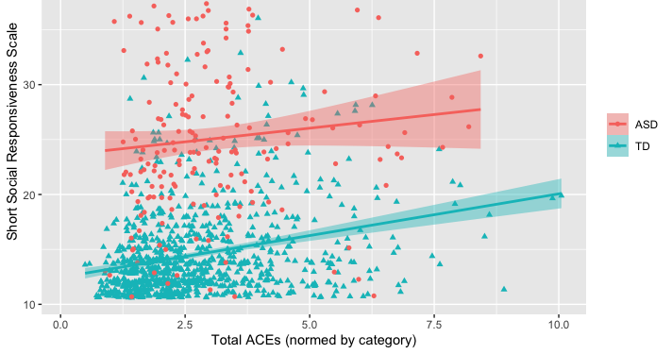
Short Social Responsiveness Scale

Slide 16
Moderating the relationship between ACEs and PTSD Symptoms
(Short) Social Responsiveness Scale
Adverse Childhood Experiences
ASD
PTSD Symptoms
TD

Slide 17
Moderation by SSRS

Slide 18
Conclusions
The ABCD dataset confirms previous findings of more Adverse Childhood Experiences and more PTSD symptoms in individuals with ASD compared to matched TD youth.
Overall, the relationship between ACEs and PTSD symptoms is similar between ASD and TD youth.
In TD youth, ADHD problems partially mediates the relationship between ACEs and PTSD.
In ASD and TD youth, social responsiveness moderates the relationship such that lower social skills is associated with greater PTSD symptoms per ACE

Slide 19
Future Direction
Explore
Explore bullying measures
Examine
Examine fcMRI measures provided by the ABCD study in areas of interest
Follow
Follow sample longitudinally
Use
Use local data to better understand sensory component
Notes:
The complete follow-up data for the ABCD will be released in September of this year which will allow us to study the entirety of the ABCD Study cohort and will more than double our sample size of ASD participants. We also plan to explore bullying measures which were not included within our current ACEs battery and improve our matching protocol to account for the effect of siblings within the study cohort. We will also be investigating functional connectivity MRI data in areas of interest such as the thalamus, amygdala, and salience network and because we are interested in the correlation between connectivity in these areas and PTSD and autism symptoms.

Slide 20
Thank You!
Jillian Melbourne
Mirella Dapretto PhD
Shula Green, PhD
Katherine E. Lawrence, PhD
Leanna Hernandez, PhD
Nana Okada
Kaitlin Cummings
Jiwon Jung
Genevieve Patterson
Notes:
I would like to thank firstly my amazing mentor Dr. Emily Wood who is the co-author of this presentation as well as everyone in the Dapretto and Green lab. Thank you for listening.

Slide 21
ABCD MRI Protocol
Structural MRI : T1-weighted and T2-weighted (T2w) structural MRI (sMRI),
Diffusion MRI (dMRI),
Functional MRI (fMRI)
Resting-State fMRI (rs-fMRI)
Task-fMRI The fMRI
Modified Monetary Incentive Delay Task (MID)
Stop Signal Task (SSTemotional)
N-Back Task (EN-back)
Hagler, D. J. et al. Image processing and analysis methods for the Adolescent Brain Cognitive Development Study. NeuroImage 202, 116091 (2019).
Notes:
Scanning requires around 2 hours to complete with a break in the middle if requested by participant
There is the option to split scanning up into two sessions within a one week period however only 3.5% of the sample opted to do this
Imaging pilot analysis of 30 participants showed no more fatigue for one scan compared to two when measured by task performance and self report
The scan sessions had a fixed scan type order across participants although in the case of task-based fMRI the 3 tasks were randomized to account for the cognitive effort associated with task-based fMRI
Over 79% of the participants completed imaging protocol

Slide 22
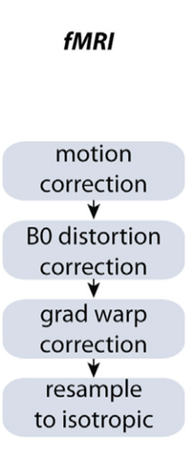
rsfMRI Pre-Processing
Removal of initial frames
Normalization of voxel time series
Regression
Temporal Filtering
Calculation of ROI-average time courses
Hagler, D. J. et al. Image processing and analysis methods for the Adolescent Brain Cognitive Development Study. NeuroImage 202, 116091 (2019).
Notes:
In addition to general fMRI pre-processing, rs-fMRI data underwent the removal of initial frames to ensure equilibration of the T1w signal, normalization of voxel time series by dividing by the mean across time of each voxel, regression, temporal filtering, and calculation of ROI-average time courses

Slide 23
Brain Segmentation
Subcortical structures are labelled using an automated, atlas-based, volumetric segmentation procedure (Fischl et al., 2002)
Cortical gray matter and underlying white matter voxels are assigned based on surface-based nonlinear registration to the atlas based on cortical folding patterns (Fischl et al., 1999b) and Bayesian classification rules (Desikan et al., 2006; Destrieux et al., 2010)
Functionally-defined parcels, based on resting-state correlations in fMRI (Gordon et al., 2016), are resampled from atlas-space to individual subject-space, and used for resting-state fMRI analysis
Hagler, D. J. et al. Image processing and analysis methods for the Adolescent Brain Cognitive Development Study. NeuroImage 202, 116091 (2019).

Slide 24
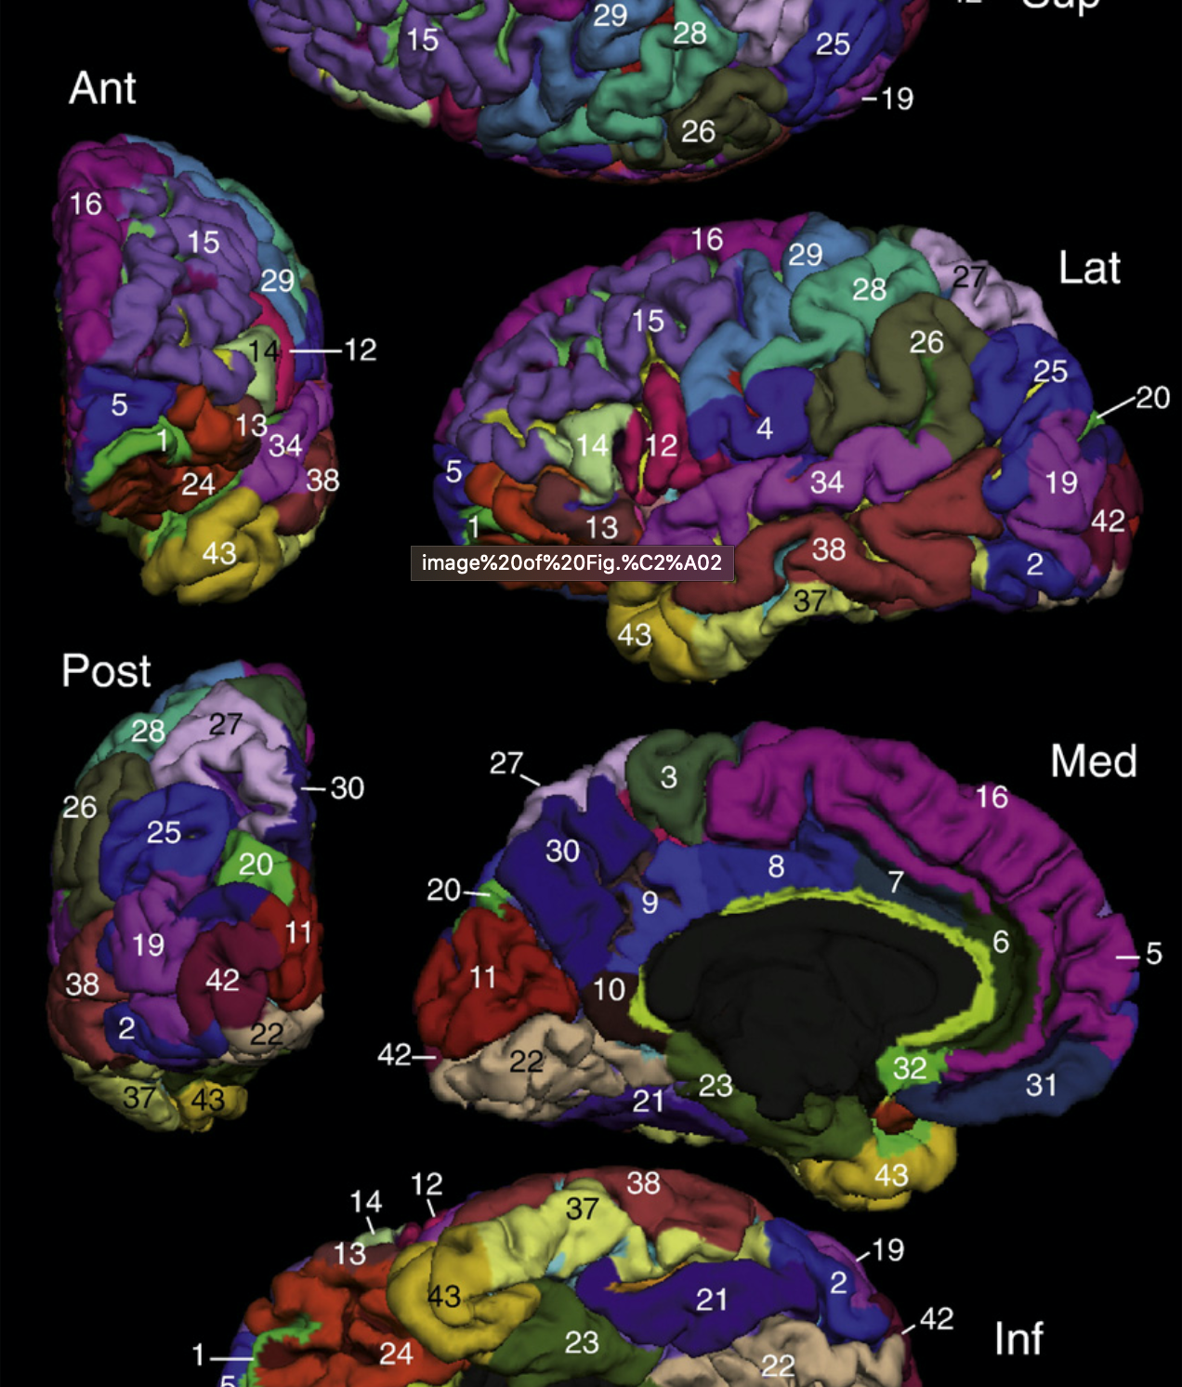
Destrieux et al., 2010

Slide 25
RSFC Post-Processing
Network Correlation Analysis
Different regions of interest (ROIs) were defined using Free Surfer’s anatomically defined parcellations and Gordon Parcellations
ROI’s correlated pair-wise using Fisher to z-statistic averaged within or between networks
Gordon, E. M. et al. Generation and Evaluation of a Cortical Area Parcellation from Resting-State Correlations. Cereb. Cortex 26, 288–303 (2016).
Notes:
Parcels defined by Gordon 2016 and were found to have more clearly defined boundaries and higher homogeneity than null conditions

Slide 26
Works Cited
Barrett, A., and T.W. Vernon. “Autism and Aces: Symptom Presentation of Children with Autism Spectrum Disorder after Adverse Childhood Experiences and Trauma.” s. n., INSAR 2019 Annual Meeting, May 1-4, Montreal Canada Abstract Book, 2019. Haruvi-Lamdan, N., Horesh, D. & Golan, O. PTSD and Autism Spectrum Disorder: Co-morbidity, Gaps in Research, and Potential Shared Mechanisms. Psychol. Trauma (2017). doi:10.1037/tra0000298
Hoffman, E.A., Clark, D.B., Orendain, N., Hudziak, J., Squeglia, L.M., & Dowling, G.J. (2019) Stress exposures, neurodevelopment and health measures in the ABCD study. Neurobiology of Stress, 10(October 2018), 100157.https://doi.org/10.1016/ j.ynstr.2019 .100157
Mehtar, M. & Mukaddes, N. M. Posttraumatic Stress Disorder in individuals with diagnosis of Autistic Spectrum Disorders. Res. Autism Spectr. Disord. 5, 539–546 (2011).
Hoover, D. W. & Kaufman, J. Adverse childhood experiences in children with autism spectrum disorder. Curr. Opin. Psychiatry 31, 128–132 (2018).
Kerns, C. M., Newschaffer, C. J. & Berkowitz, S. J. Traumatic Childhood Events and Autism Spectrum Disorder. J. Autism Dev. Disord. 45, 3475–3486 (2015).
Roberts, A. L., Koenen, K. C., Lyall, K., Robinson, E. B. & Weisskopf, M. G. Association of autistic traits in adulthood with childhood abuse, interpersonal victimization, and posttraumatic stress. Child Abus. Negl. 45, 135–142 (2015).
Storch, E. A. et al. The phenomenology and clinical correlates of suicidal thoughts and behaviors in youth with autism spectrum disorders. J. Autism Dev. Disord. 43, 2450–2459 (2013).

